Slide 1
Note: Prof. Q. said I don’t need to have high-fidelity for all pages, so I included 5

Slide 2
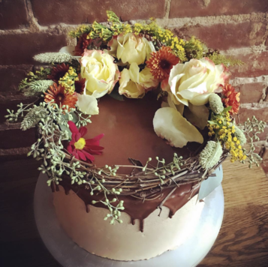


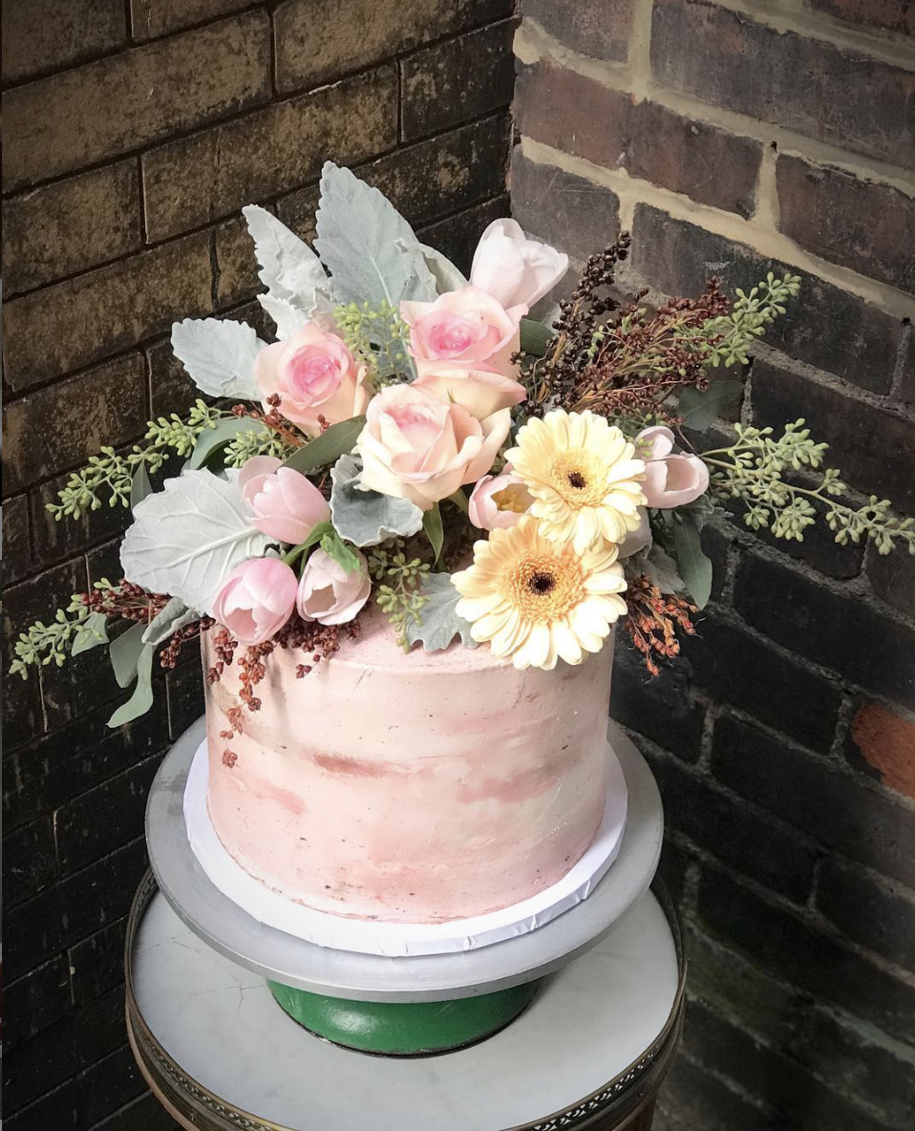
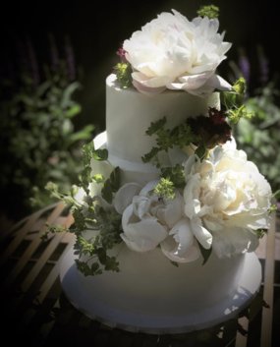
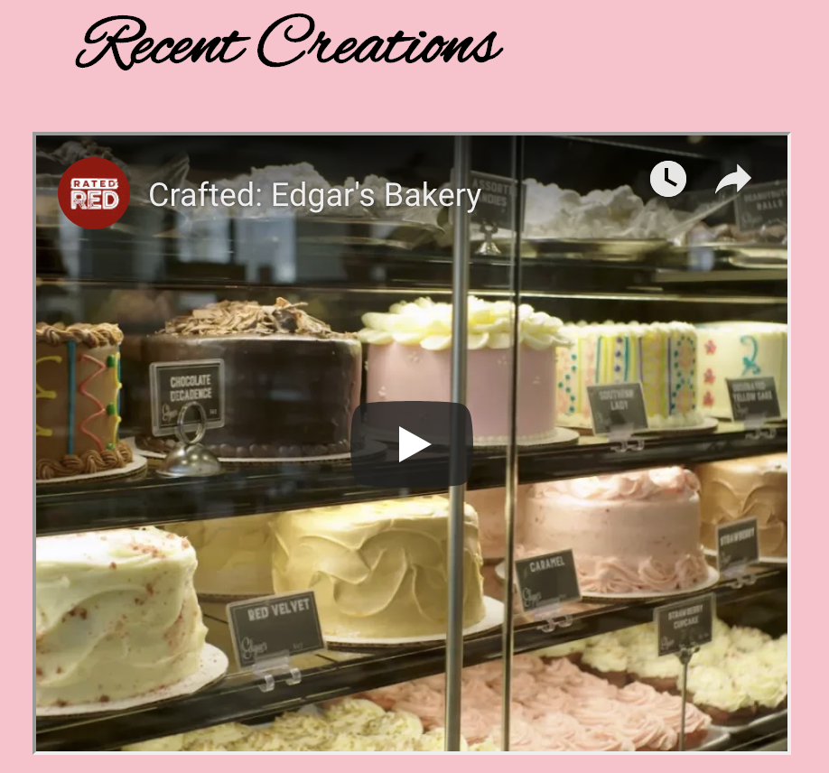

About Menu Order Contact Location
About Menu Order Contact Location
Wedding Graduation Anniversary Religious Celebration
Slide shows of pictures
Weddings are such a joyous occasion and each one is different! The same is true of our wedding cakes. We have an almost unlimited combination of flavors and styles to choose from.

Slide 3
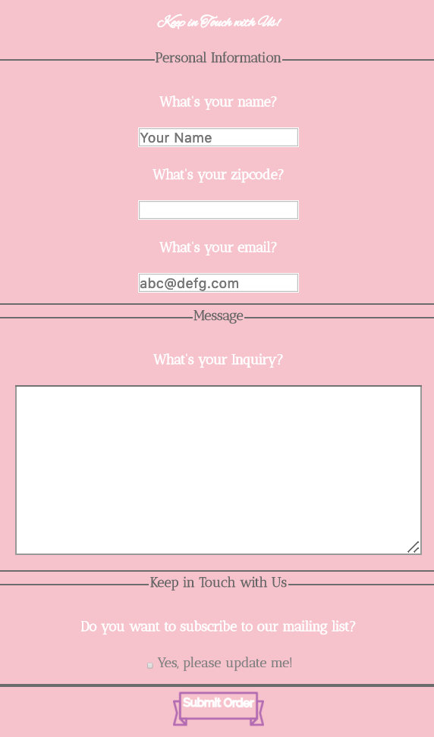
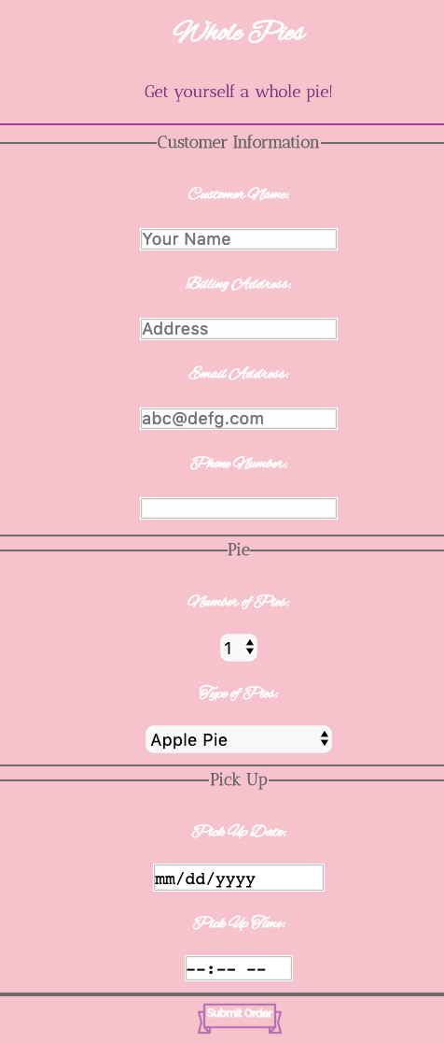
About Menu Order Contact Location
About Menu Order Contact Location
Contact Us Find Us
Other Pies

Slide 4

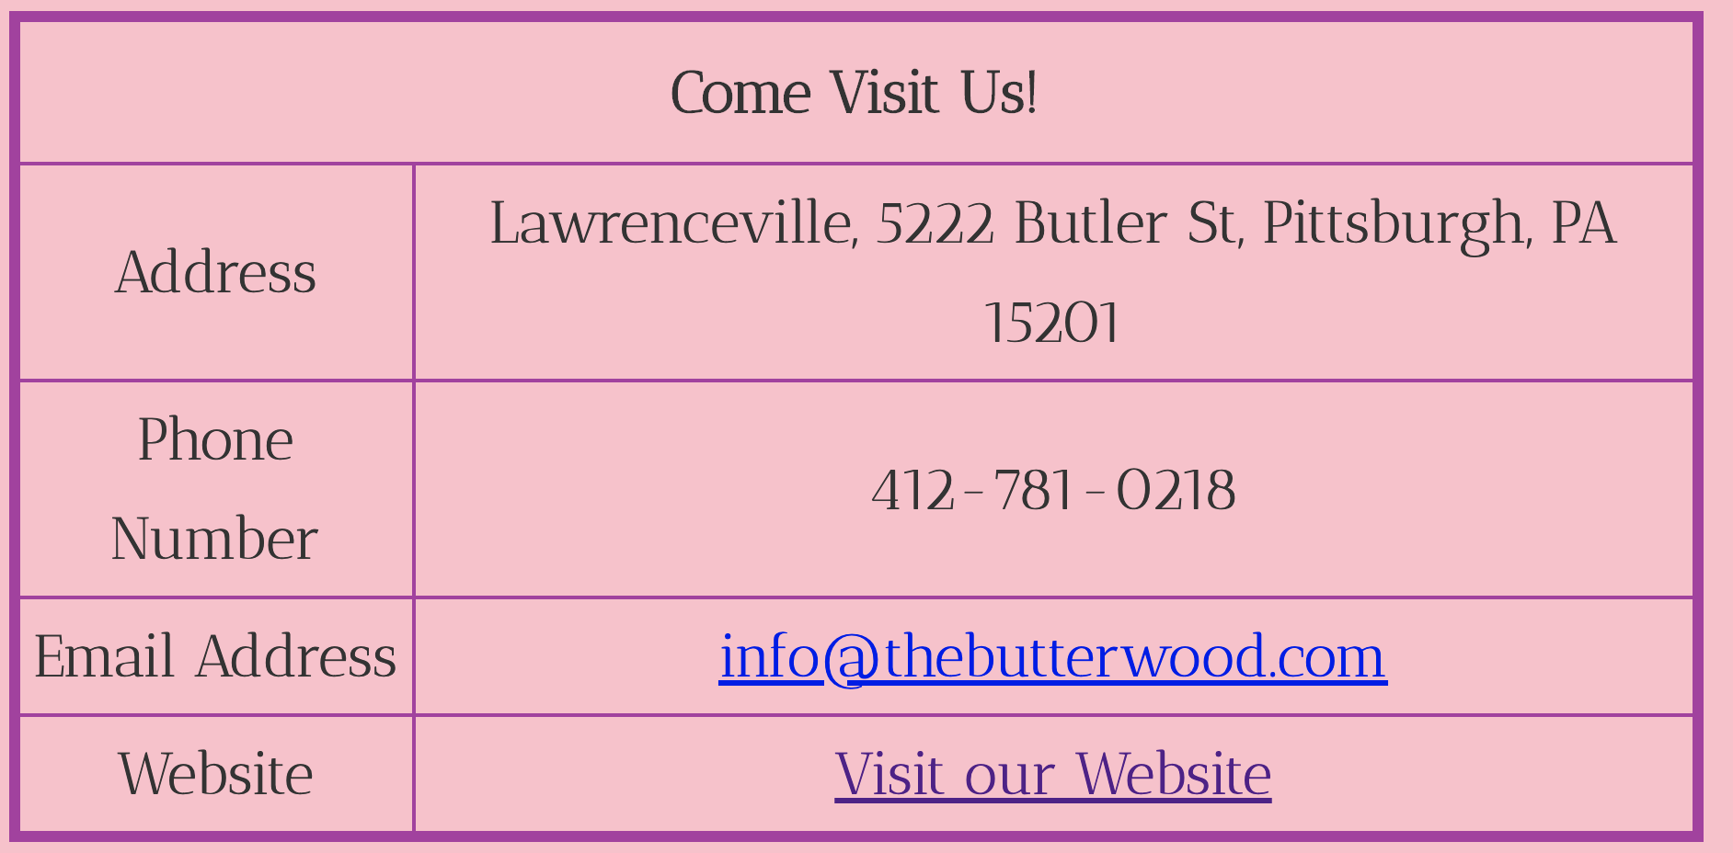
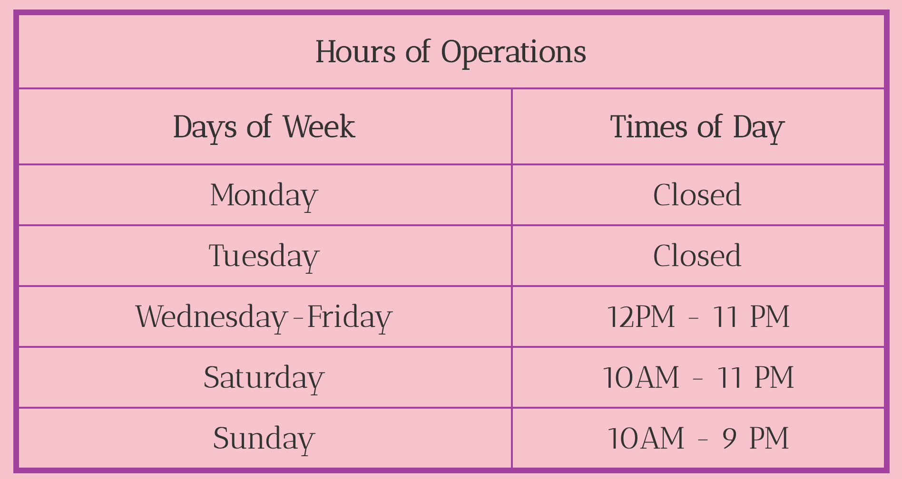
About Menu Order Contact Location
Contact Us Find Us

